Slide 1


Slide 2
Udeploy
IBM UrbanCode Deploy orchestrates and automates the deployment of applications, databases and configurations into development, test and production enviroments,helping to drive down cost and speed time to market with reduced risk
Key Features
Multi-Tier Application Models
Easy Process Designer
Track What is Where: Inventory
Scalable Distributed Automation
Quality Gates and Approvals
Integrations Replace Custom Scripting

Slide 3
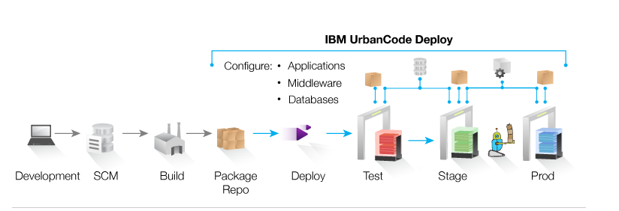
Typical Uses
Continuous Delivery: Integrate with build and test tools to automatically deploy, test and promote new builds
Production Deployments: Orchestrate a complex production deployments of applications and configuration
Self-Service: Grant different teams rights to “push the go button” for different applications and environments
Incremental Updates: Deploy only the changes components or missing incremental (patch) versions

Slide 4
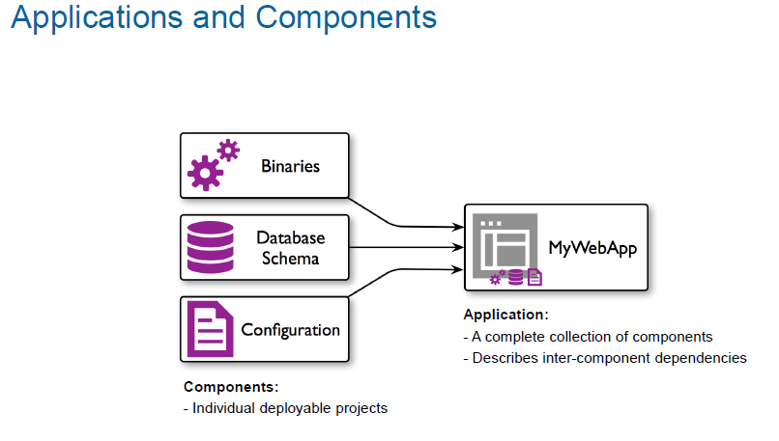

Slide 5
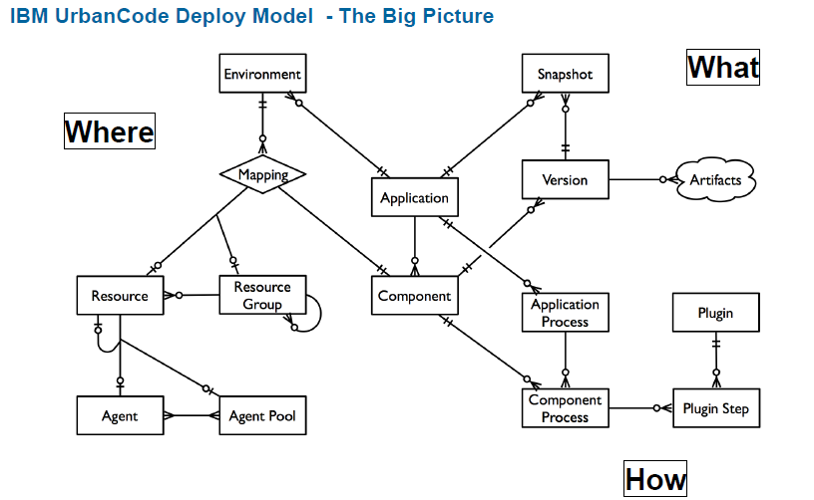

Slide 6
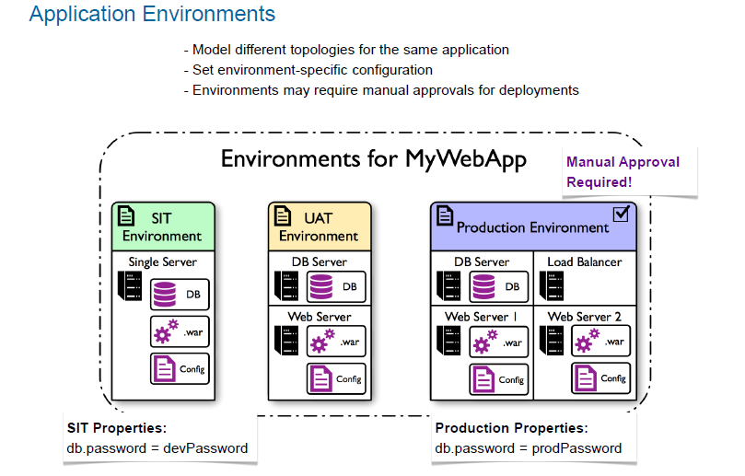

Slide 7
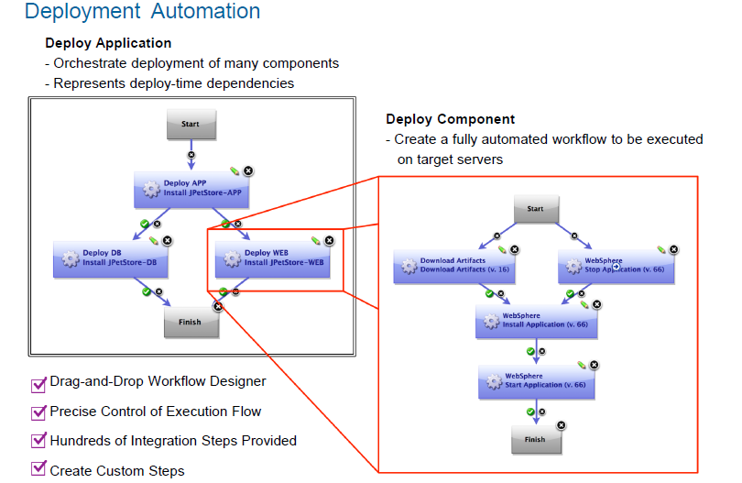

Slide 8
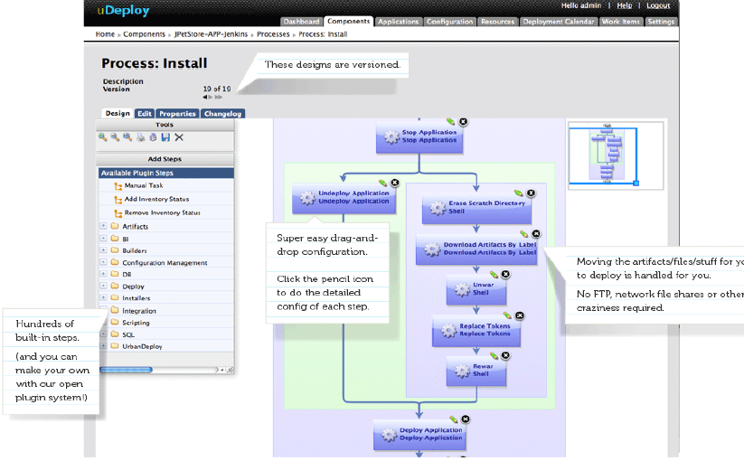

Slide 9
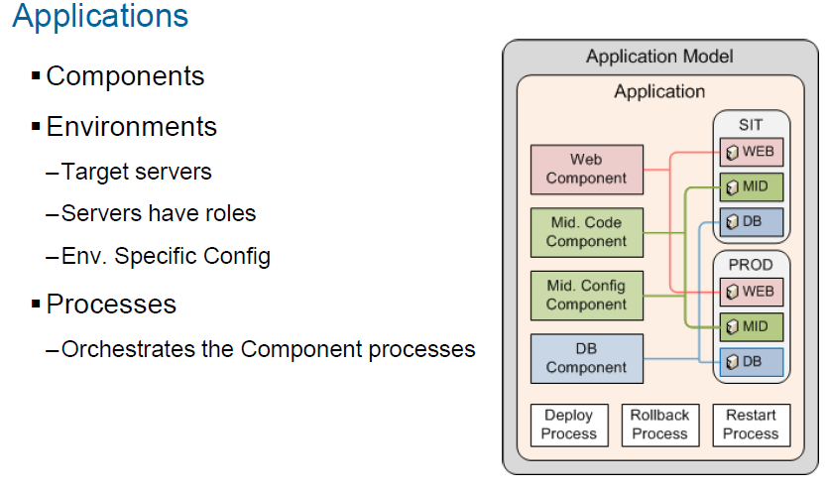

Slide 10
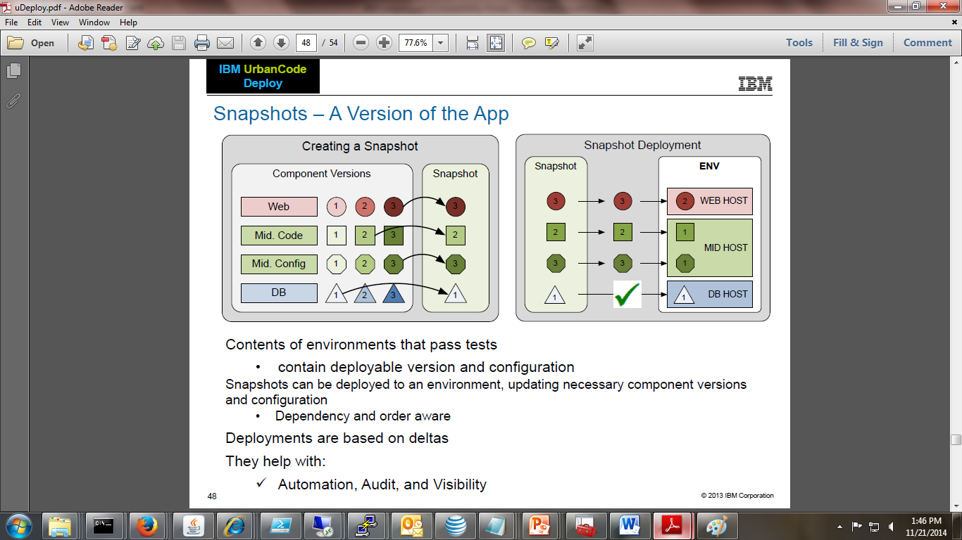

Slide 11

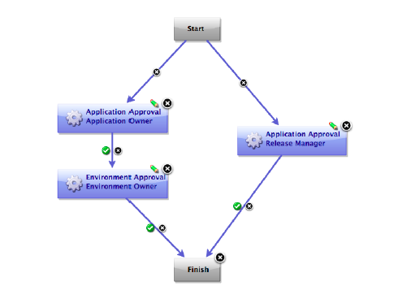

Slide 12
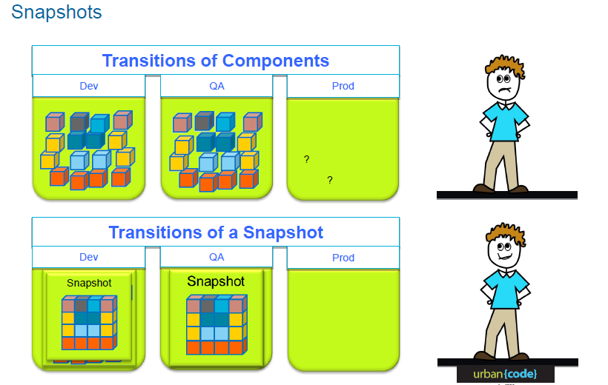
snapshots

Slide 13
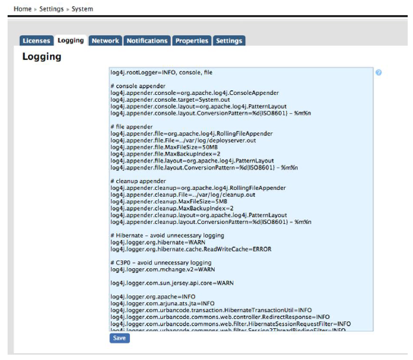
Logging

Slide 14
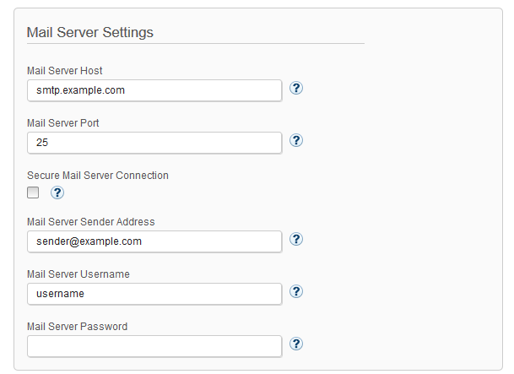
Notifications

Slide 15
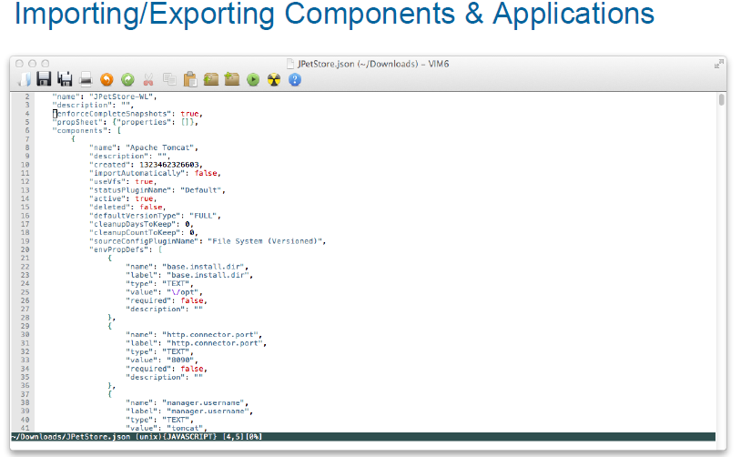

Slide 16
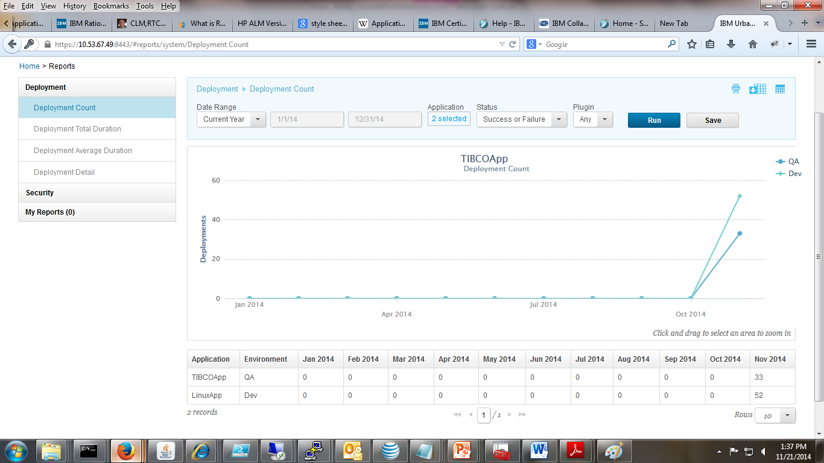


Slide 17
Thank you
Visit us at www.techmahindra.com

